Slide 1

Operators

Slide 2
Objectives
Last session recap
Assignment Operators
2.4
01
Comparison Operators
2.3
Logical Operators
2.2
Arithmetic Operators
2.1
03
C# Operators
02
Exercises & Assignment
PACE Coding Program 2019

Slide 3
1. Last Class Recap

Slide 4


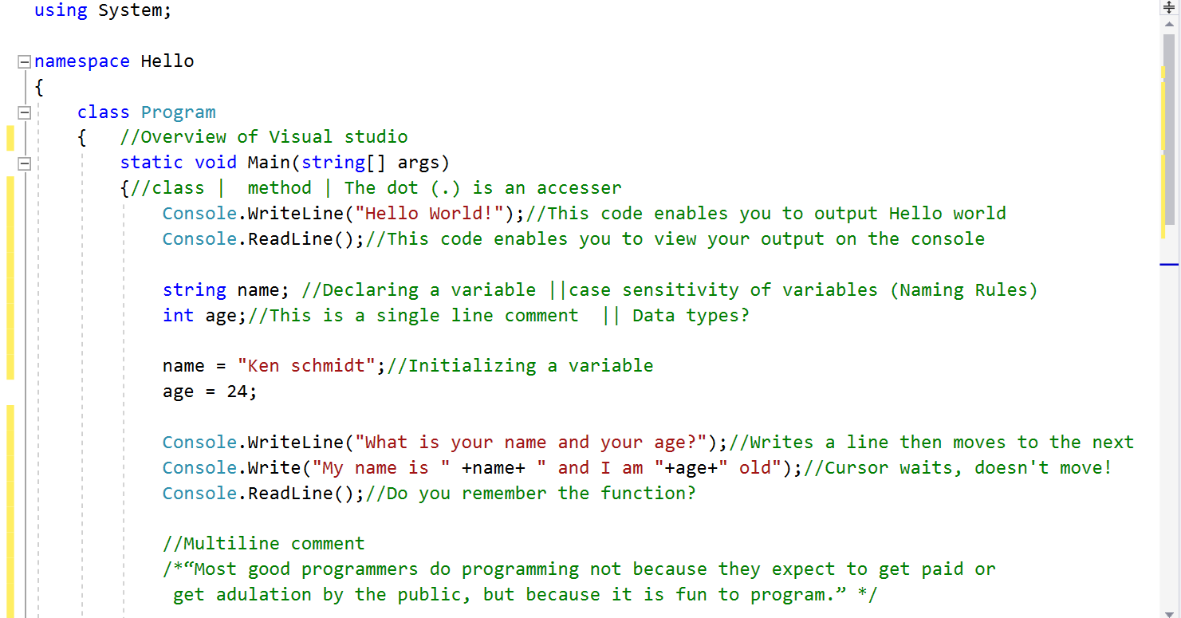

Slide 5
2.0. Operators

Slide 6
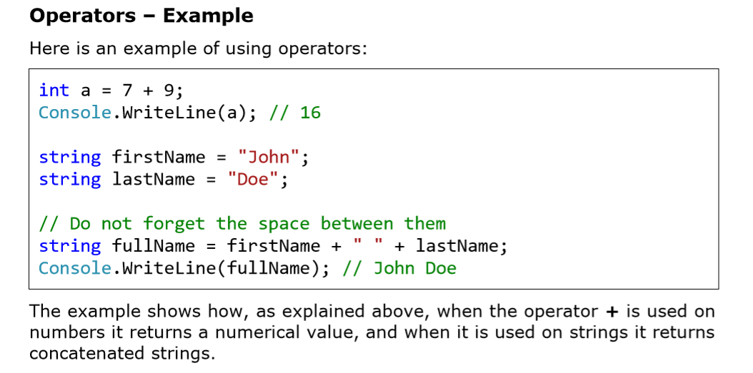

Slide 7
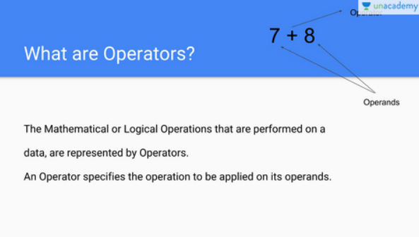

Slide 8
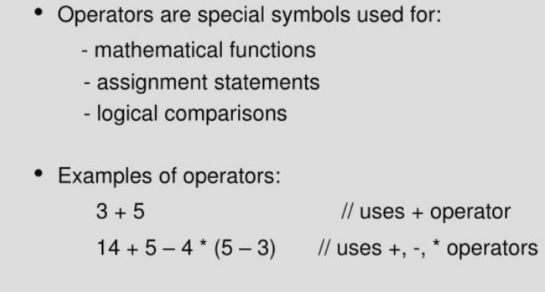

Slide 9
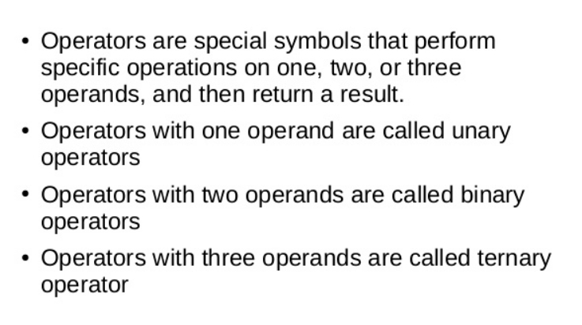

Slide 10
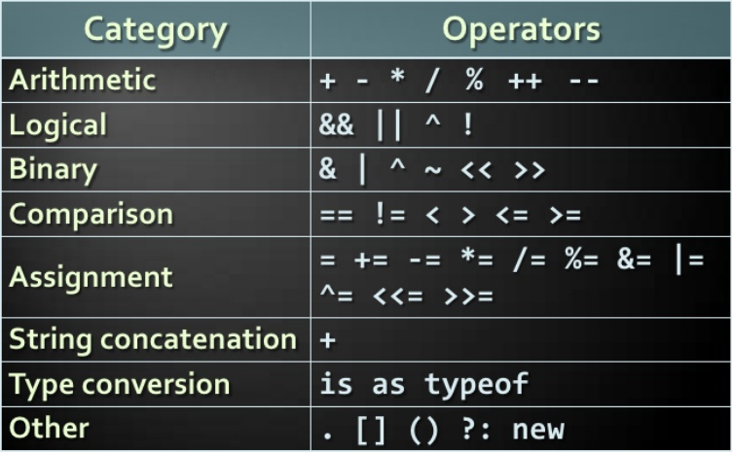

Slide 11
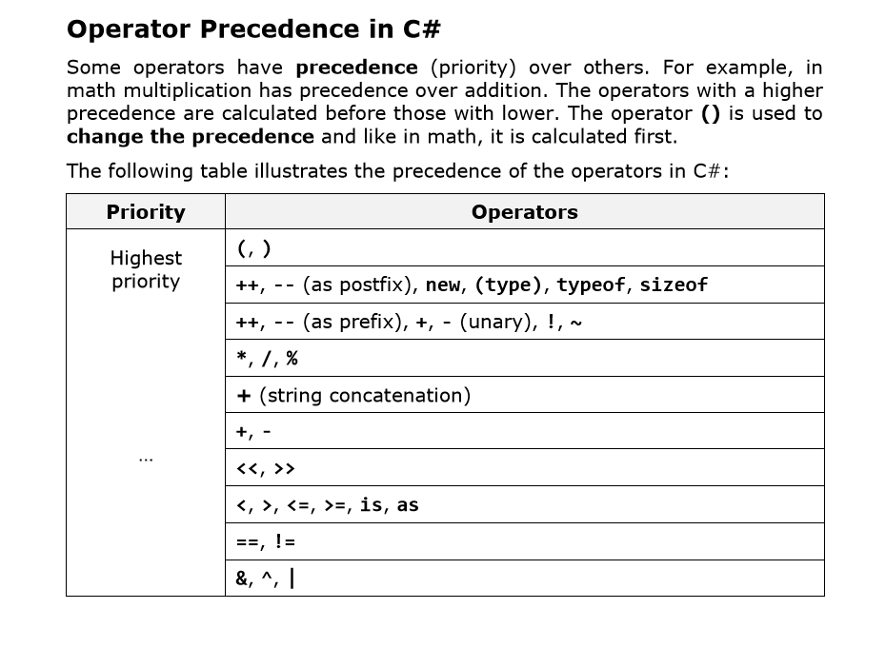

Slide 12
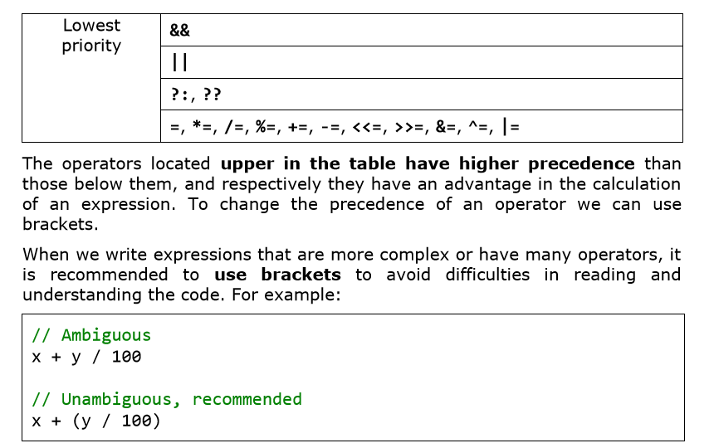

Slide 13
2.1. Arithmetic Operators
Arithmetical operators in C# (+, -, *) are the same like the ones in math. They perform addition, subtraction and multiplication on numerical values and the result is also a numerical value.

Slide 14
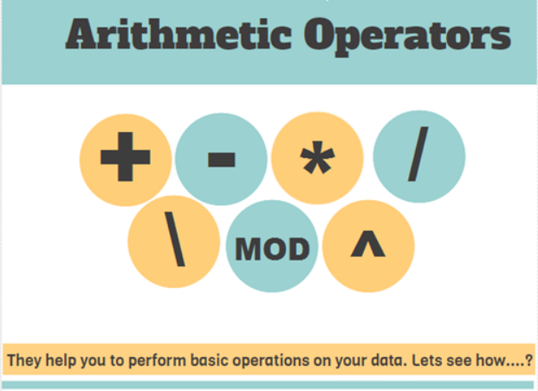

Slide 15
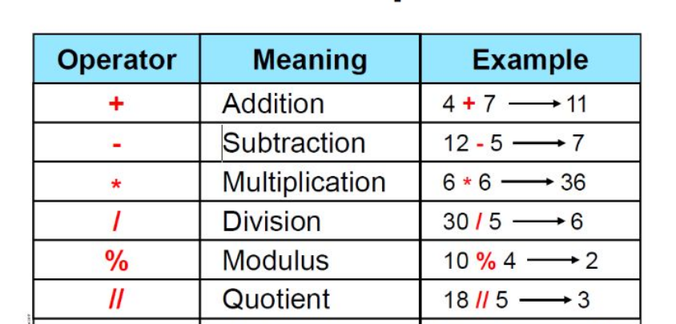

Slide 16
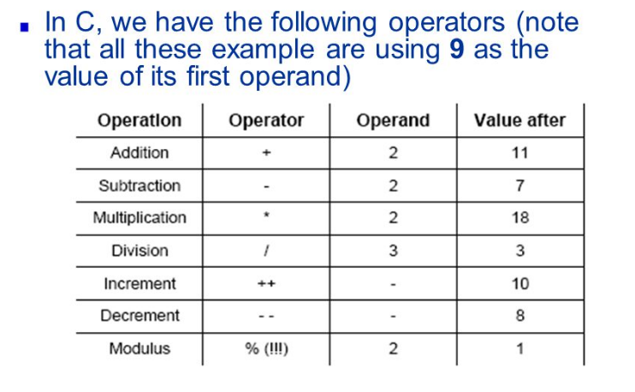
Examples cont’d…
Note that all these examples are using 9 as the value of their first operand

Slide 17
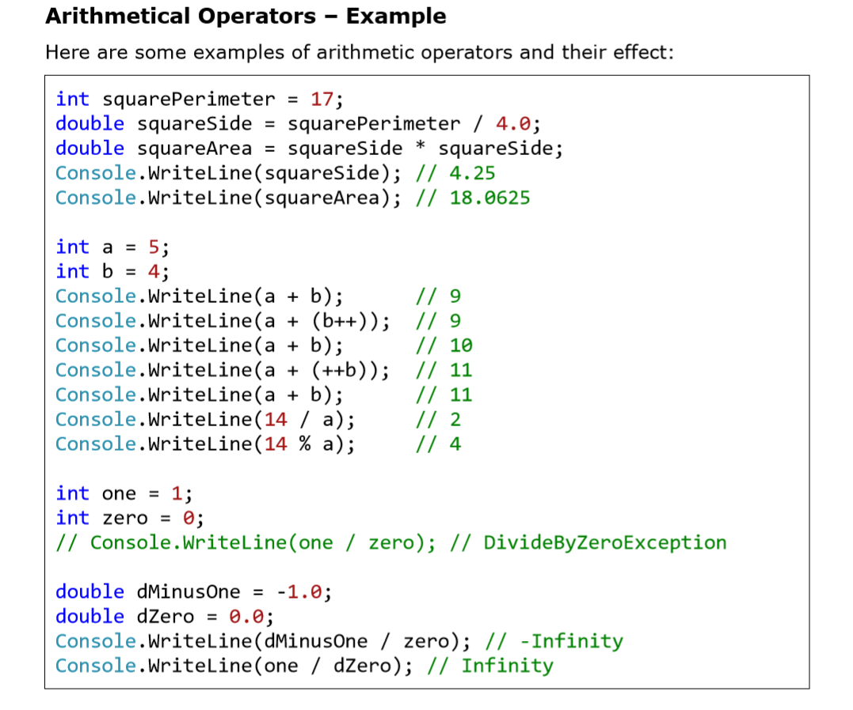

Slide 18
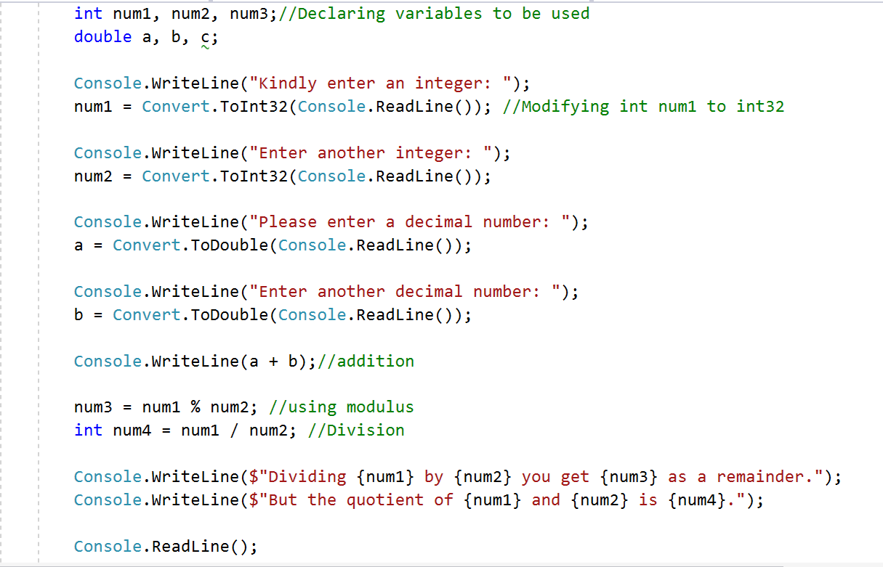

Slide 19
2.2. Logical Operators
Logical (Boolean) operators take Boolean values and return a Boolean result (true or false). The basic Boolean operators are "AND" (&&), "OR" (||), "exclusive OR" (^) and logical negation (!).

Slide 20
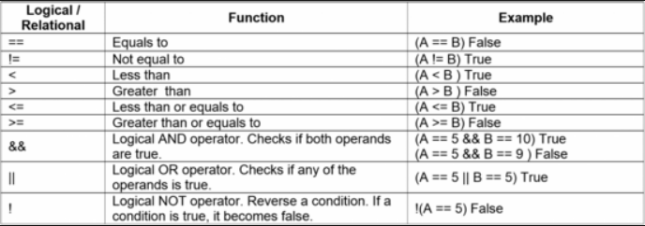

Slide 21
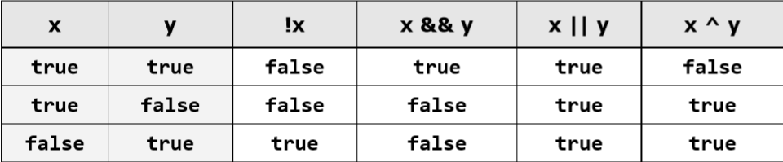
Logical operators in C# and operations they perform

Slide 22
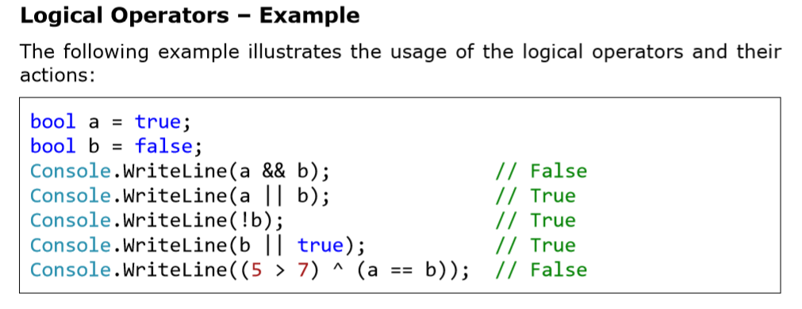

Slide 23
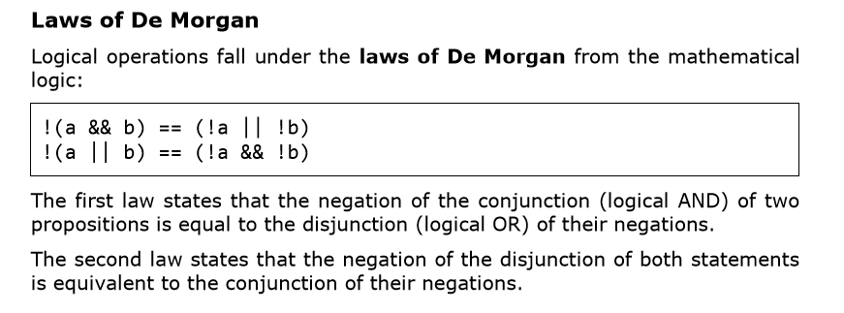

Slide 24
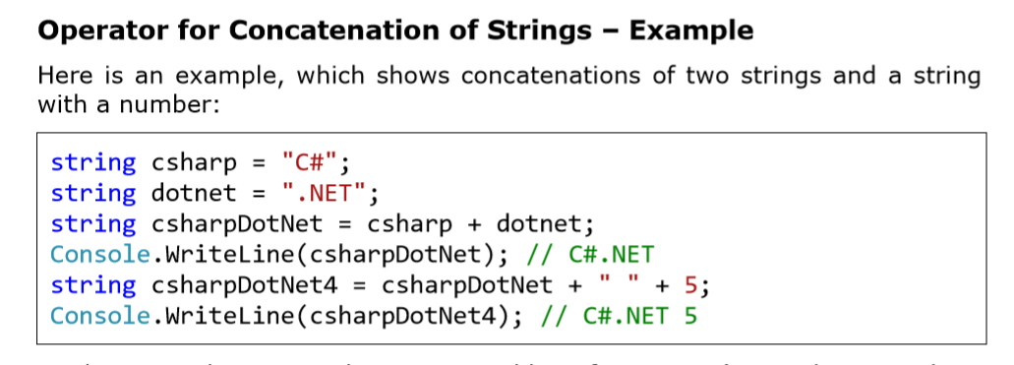

Slide 25
2.3. Comparison Operators
Also known as relational operators!
Comparison operators in C# are used to compare two or more operands.

Slide 26
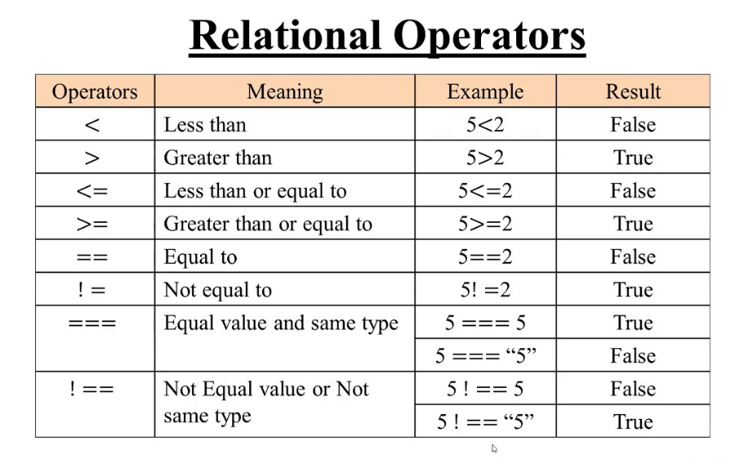

Slide 27
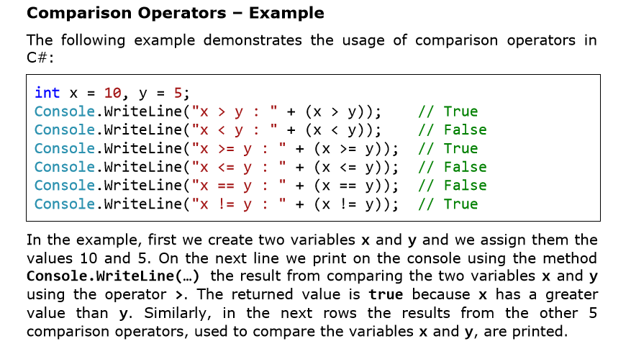

Slide 28
2.4. Assignment Operators

Slide 29
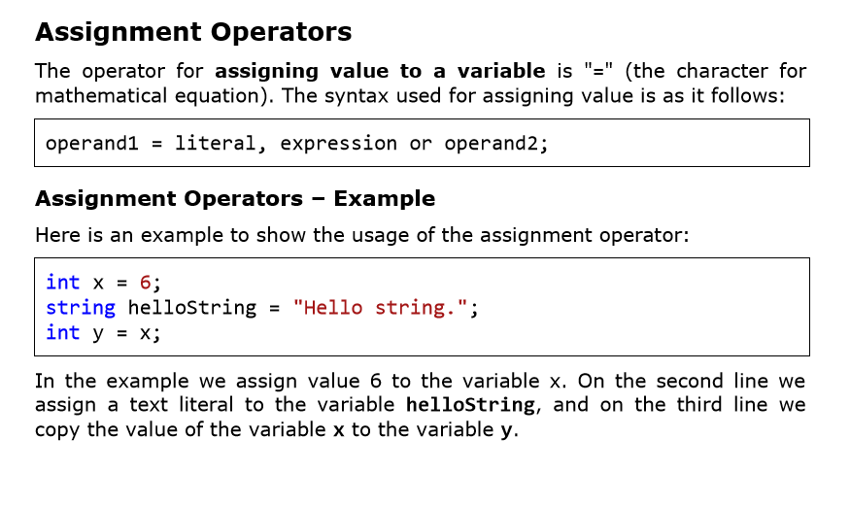

Slide 30
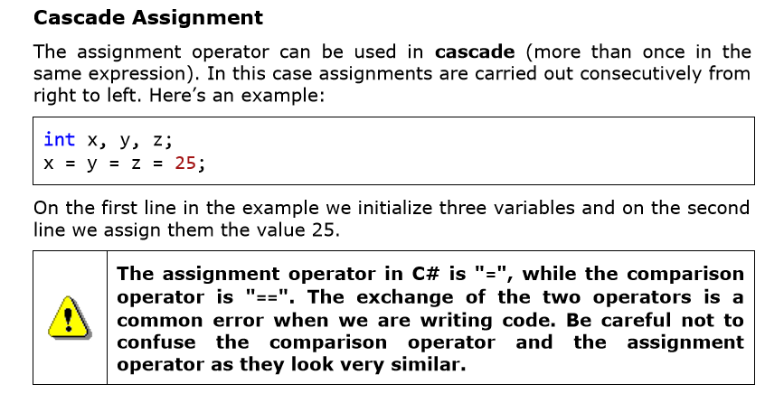

Slide 31
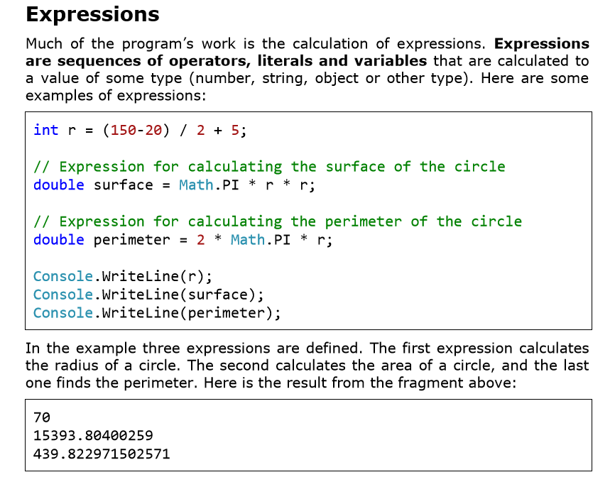

Slide 32
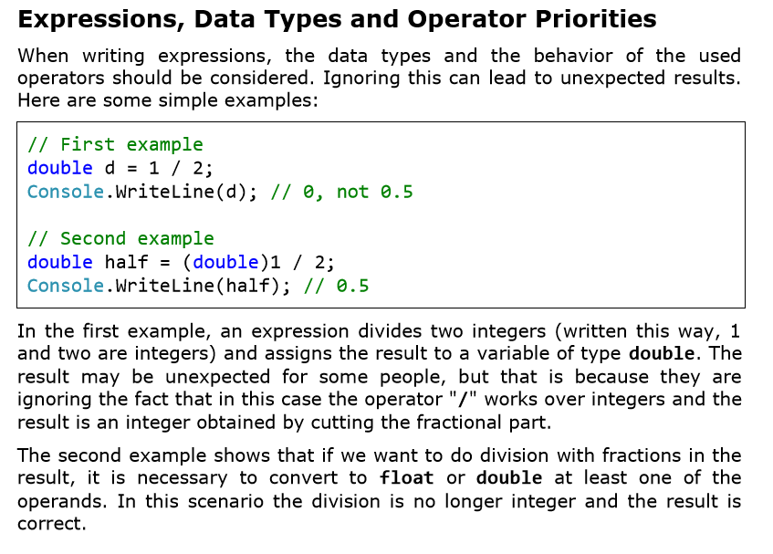

Slide 33
03. Exercises

Slide 34
Exercise 1
Write a program that prints on the console the perimeter and the area of a rectangle by given side and height entered by the user.

Slide 35
Exercise 2
Write a code that calculates the area of a circle whose radius is 2.50 centimeters. Remember that the area of a circle is the radius squared multiplied by pi. one hint: .net contains a constant for pi, Math.PI that you can use for that value.

Slide 36
Assignments

Slide 37
Assignment 1
The gravitational field of the moon is approximately 17% of that on the earth. Write a program that calculates the weight of a man on the moon by a given weight on the earth.

Slide 38
ASSIGNMENT 2
Write an expression that checks whether an integer is odd or even.

Slide 39
Assignment 3
Write an expression that calculates the area of a trapezoid by given sides a, b and height h. Hint (the formula for trapezoid surface is: S = (a + b) * h / 2)

Slide 40
The End
☺
Ooko Emmanuel

